Slide 1
Mobilizing Business on Early Childhood Education
Julia Barfield, MSW, MPH
Senior Manager Policy and Programs
Center for Education and Workforce, U.S. Chamber Foundation

Slide 2
Let’s envision how
our families,
our businesses,
and our communities
will thrive with
access to childcare.
uschamberfoundation.org/EarlyEd

Slide 3
Childcare is a Crucial Economic Driver
A Strong Workforce
High-quality, affordable, accessible early childhood education ensures
Strong Businesses
A Strong Economy

Slide 4
Challenges Facing Today’s Workforce
By 2020, there will be 6 million unfilled jobs.
40% of businesses can’t take on more work because they can’t fill the jobs they have.

Slide 5
Demographics of Today’s Workforce
Almost 12 million children are in paid, non-parental care before they start school
2/3 of women with children under 5 work outside of the home

Slide 6
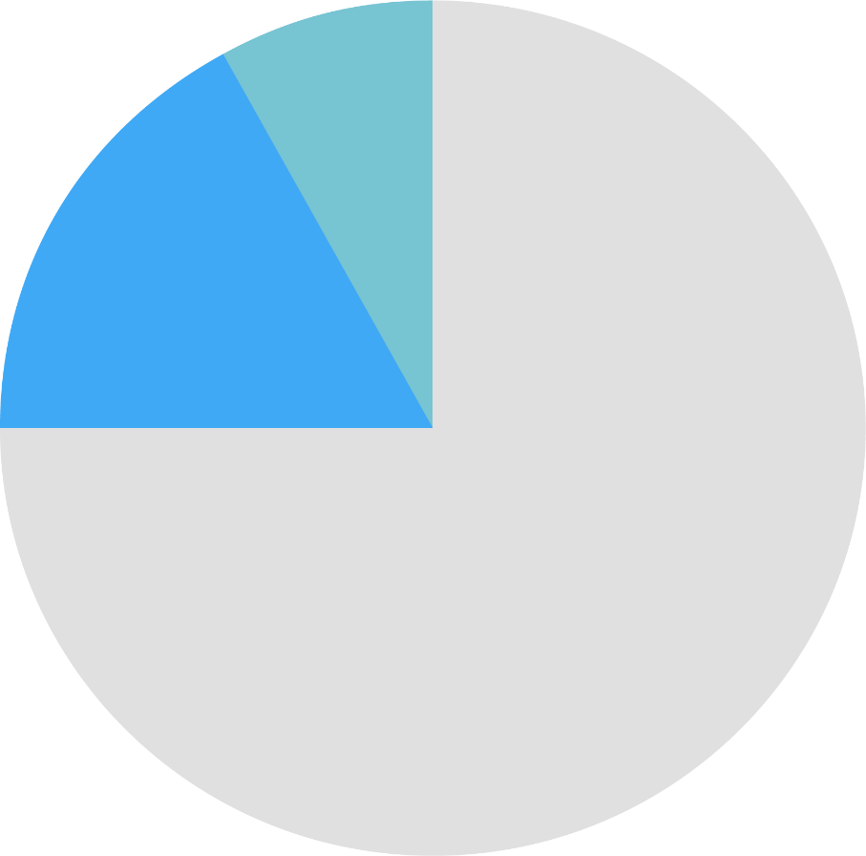
Demographics of Today’s Workforce
8 of every 10 births today are to millennials who make up 1/3 of today’s workforce
1/4 of college students are raising children; more than 50% of them have children under age 5.

Slide 7
The Impact on Business
Breakdowns in childcare cost businesses more than $3 billion a year
Almost 13 million Americans in their prime working years have children under age 6.

Slide 8
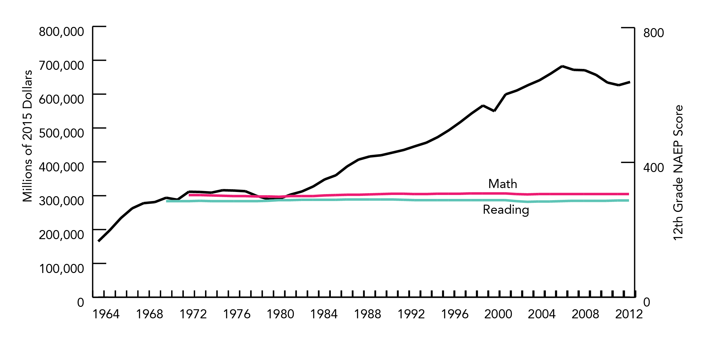
Education Challenges

Slide 9
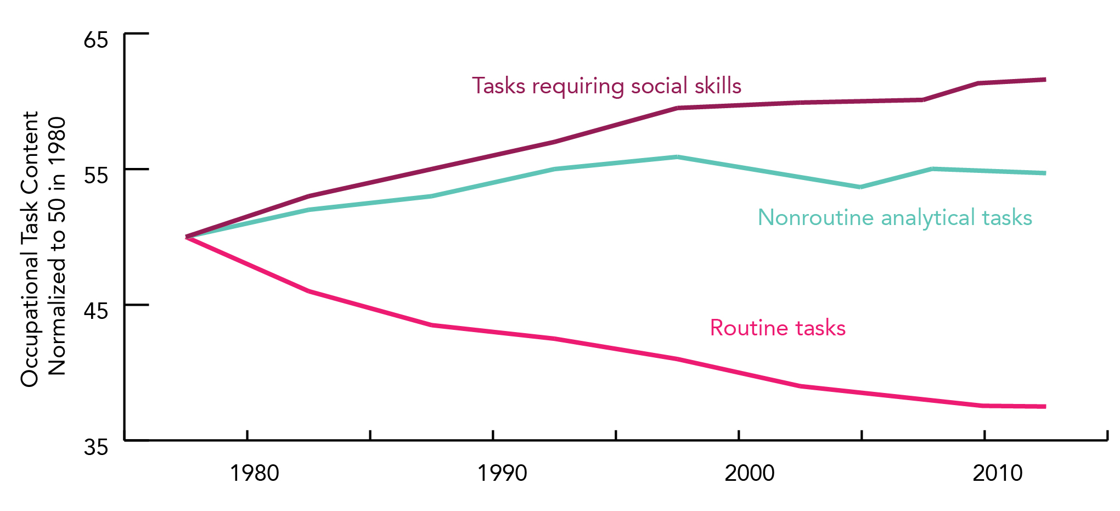
Changing Skills in Our Labor Market

Slide 10
Everyone has a role to play:
LEADERSHIP
from both the
PRIVATE SECTOR
PUBLIC SECTOR
and

Slide 11
Action Plan: Where to Start
1
ASSESS THE NEED in your community
LEARN THE LANDSCAPE to understand the problem
2
3
FIND YOUR PARTNERS because the champion can’t carry the team alone

Slide 12
A Matrix of Options
COMMUNITY-WIDE IMPACT EMPLOYER-FOCUSED IMPACT
Easy to do. Minimal resources. High impact. | Easy to do. Minimal resources. Lower impact.
Not easy to do. Extensive resources. High impact. | Not easy to do. Minimal resources. Lower impact.
HIGH RESOURCE LOW RESOURCE

Slide 13
A Matrix of Options
COMMUNITY-WIDE IMPACT EMPLOYER-FOCUSED IMPACT
FLEXIBLE SCHEDULES
SHARED SERVICES
BACK-UP CHILDCARE
PUBLIC ADVOCACY
HIGH RESOURCE LOW RESOURCE
SUBSIDIZED SLOTS
FACILITIES INVESTMENTS
MULTI-SECTOR APPROACH
ON-SITE CHILDCARE

Slide 14
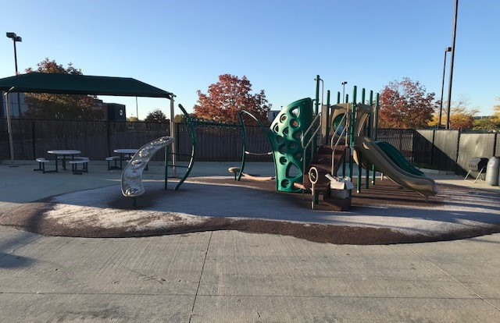
On-Site Childcare
FEATURING

Slide 15
Back-Up Childcare
FEATURING

Slide 16
Multi-Sector Approach
FEATURING

Slide 17
Shared Services & Innovative Financing

Slide 18
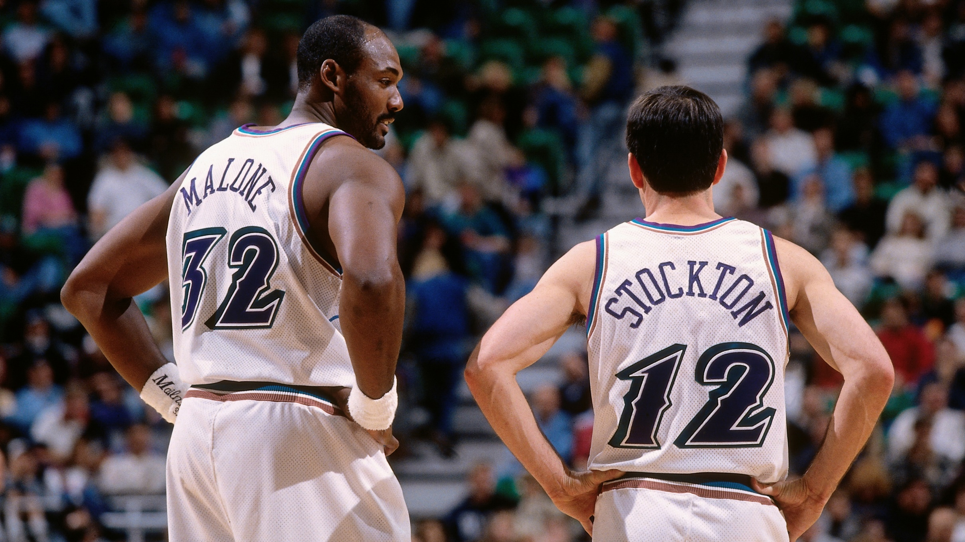

Slide 19
Let’s envision how
our families,
our businesses,
and our communities
will thrive with
access to childcare.
uschamberfoundation.org/EarlyEd

Slide 20
JULIA BARFIELD
jbarfield@uschamber.com
@juliapbarfield
@USCCFeducation
THANK YOU
uschamberfoundation.org/EarlyEd

