Slide 1
Investing in Montana’s workforce infrastructure: Early care and education as economic development
Ben Horowitz
Senior Project Manager
Federal Reserve Bank of Minneapolis*
Benjamin.Horowitz@mpls.frb.org
*The views expressed here are those of the author and not necessarily those of the Federal Reserve Bank of Minneapolis or the Federal Reserve System.

Slide 2
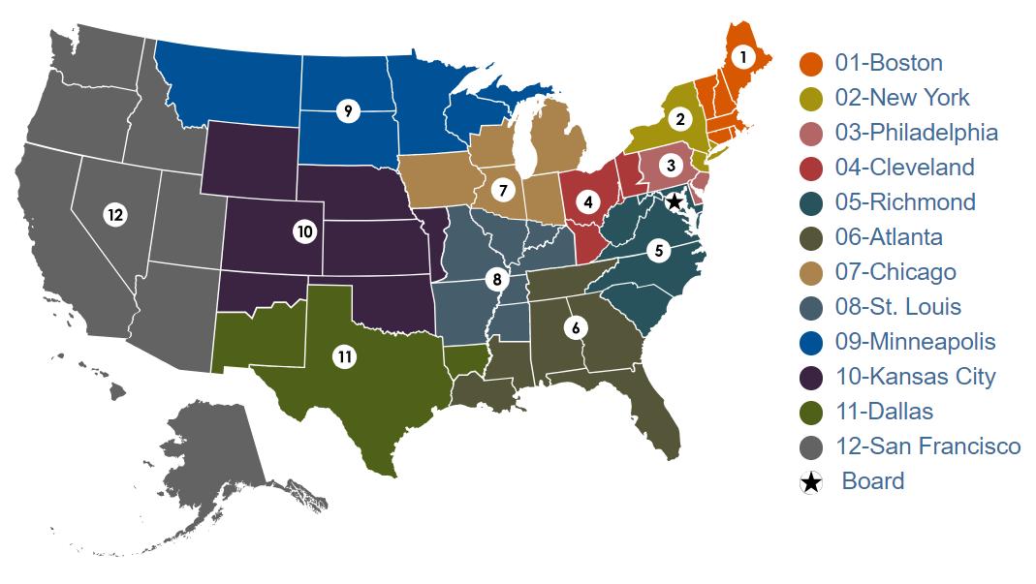
Federal Reserve System

Slide 3
Human Brain…
At Birth
At 6 Years Old
At 14 Years Old
Source: Chugani, Phelps & Mazziotta (1987)

Slide 4
Human Brain Development Synapse Formation Dependent on Early Experiences
Language
Sensory Pathways
(Vision, Hearing)
Higher Cognitive Function
FIRST YEAR
-8 -7 -6 -5 -4 -3 -2 -1 1 2 3 4 5 6 7 8 9 10 11 1 2 3 4 5 6 7 8 9 10 11 12 13 14 15 16 17 18 19
Birth
(Months)
(Years)
Source: C. Nelson (2000)

Slide 5
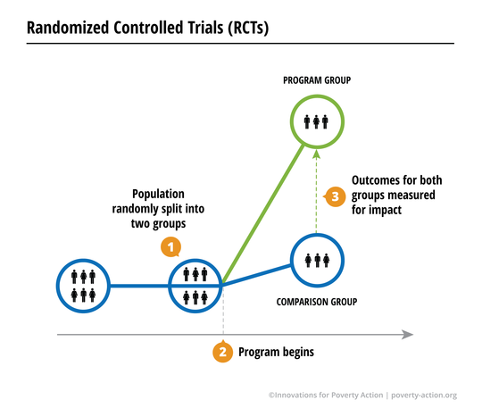
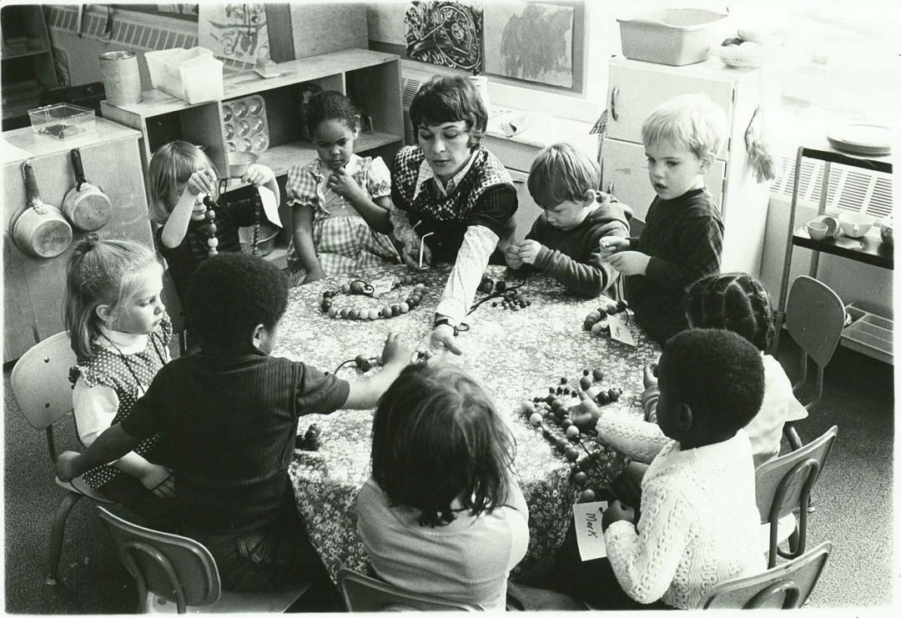
How do we learn about the economic return on investment (ROI) in early childhood programming?

Slide 6
Perry Preschool—Estimated Return on Investment
Benefit-Cost Ratio = $16 to $1
Annual Rate of Return = 18%
Public Rate of Return = 16%
Heckman Reanalysis = 10%
Sources: Schweinhart, et al. (2005); Author’s calculations; Heckman, Moon, Pinto, Savelyez, & Yavitz (2010)

Slide 7
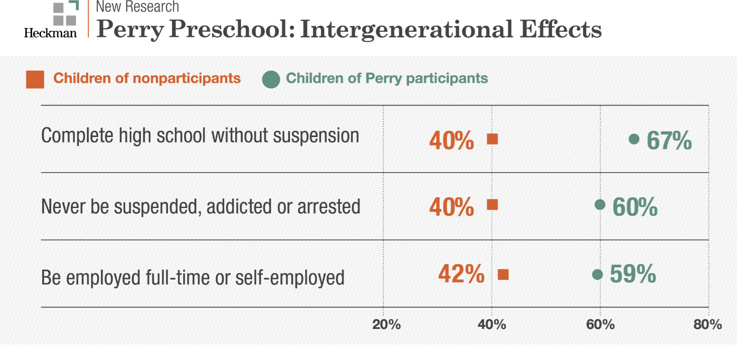
Source: Heckman & Karapakula

Slide 8
Benefit-Cost Ratios for Other Longitudinal Studies
Abecedarian Educational Child Care
$7 to $1
Chicago-Child Parent
$10 to $1
Elmira Prenatal/Early Infancy Project
$5 to $1
Sources: Garcia, Heckman, Leaf, & Prados (2016); Reynolds, Temple, White, Ou, & Robertson (2011); Karoly, et al (1998)

Slide 9
High return principles
Invest in quality
Engage parents
Start early
Bring to scale
Match services to risk profile

Slide 10
Early care and education market participants
ECE providers
Parents
Businesses
Government and taxpayers

Slide 11
Parents: Decision to trade off parental care for child care
Work vs. parental care preferences
Wages, benefits, and job conditions
Cost of child care
Quality child care threshold

Slide 12
Montana Children Under Age 6, Percent of Parents in Labor Force by Living Arrangement
Source: American Community Survey, 2013–2017 5-Year Estimates
Notes:
Montana has 73,242 children under the age of 6.

Slide 13
Montana Children Under Age 6 by Poverty Level
Total: 72,715
100% $25,750
200% $51,500
Source: American Community Survey, 2013–2017 5-Year Estimates
Notes:
Montana has 73,242 children under the age of 6.

Slide 14
Montana market rates for licensed early care

Slide 15
Licensed ECE providers in Montana

Slide 16
Early Care and Education Landscape
4,700 caregivers in licensed childcare facilities
$9.84 median hourly rate
21% hold multiple jobs
$13,454 median wage (Yellowstone)
Source: MTDLI-Understanding the Childcare Workforce-A. Watson
Montana Economy at a Glance – April 2019

Slide 17
Childcare Capacity as a Percent of Children Under Age 5 by County

Slide 18
Childcare capacity’s role in meeting workforce demands

Slide 19
Businesses: Decision to provide support for employees to access child care
Availability of workers
Costs to recruit and retain employees
Employee productivity
Bringing innovation to field

Slide 20
Recent perspectives from Montana firms on availability of childcare
Childcare effects our management team. The cost of childcare weighed against wage has been a consideration about people continuing on or deciding to stay home.
We've had people cut their hours to stay home with kids
It is limiting our workforce ability to generate new business
The cost of childcare is very high and it's a huge consideration when candidates are considering a job offer
The availability and cost of childcare has significantly affected our entry level positions as more parents are staying home as they can’t afford or find available childcare.
The cost and availability are sometimes quite detrimental to their longevity with the company and with their attendance.
Significant, in the summer months most employees work a non traditional schedule so most available childcare, if available, is typically 8 to 5pm.
Attracting qualified applicants is hindered by lack of quality childcare capacity and long waitlist for open spots.
Source: Minneapolis Fed Economic Conditions Gatekeeper Survey

Slide 21
Innovations in the Private Sector

Slide 22
So what is the Minneapolis Fed doing in Montana?
Research:
Early Childhood Development in Montana
Gatekeeper survey insights
High touch engagement
Innovations
Parent survey
Business survey
Convene
Funders for Montana’s Children
Private sector stakeholders
Public policy discussions

Slide 23
Key Takeaways
Early years are a sensitive period for brain development.
Early education investments can yield high public returns when reaching disadvantaged children.
High-quality early care and education (ECE) supports child development and parental employment.
Public policy: Provide resources to low- to moderate-income families to access a variety of high-quality ECE programs.

Slide 24
Questions?
Ben Horowitz – 612.204.6475, benjamin.horowitz@mpls.frb.org
https://www.minneapolisfed.org/publications/special-studies/early-childhood-development
https://fundersformontanaschildren.org/

